Slide 1
Lecture 14
Statistical Significance and an Introduction to Probability

Slide 2
Review
1 What is a sampling distribution?
The distribution of a statistic over all possible samples of the same size n.
2 What is the standard error?
The standard deviation of a sampling distribution; for x̄ it is SE = σ / √n.
3 What is the margin of error?
How far an estimate is expected to fall from the parameter: 2 × SE.
4 What is a linear transformation?
y = ax + b: it rescales and shifts the center and spread, but never changes the shape.

Slide 3
What you should know: the normal distribution
The two parameters
x ~ N(μ, σ): μ locates the center, σ sets the spread.
The empirical rule
68%, 95% and 99.7% within 1, 2 and 3 standard deviations (bell-shaped only).
The z-score
z = (x − x̄) / s counts standard deviations from the mean; |z| ≥ 2 flags an outlier.

Slide 4
Data: student heights
A survey of 379 college students recorded each student's height and gender.
X = the height of a student, in inches
HEIGHT | GENDER
56 | Female
57 | Female
58 | Female
60 | Female
60 | Female
… | …
n = 379 students (the file lists the women first, then the men, each sorted by height)

Slide 5
Statistical significance
Someone hands you 20 students and says they are a random sample of all 379.
x̄ = 70.33 in μ = 67.1 in SE = 0.92 in
Is this result statistically significant?
z = (70.33 − 67.1) / 0.92 ≈ 3.5: far outside the margin of error, so yes
Statistically significant: this was not a random sample of all students (they were all men)

Slide 6
Why probability?
Wednesday: about 95% of samples land within 2 SE of μ.
Today: a sample that far out would be very unlikely to happen by chance.
We only ever take one sample. So what do "95%" and "unlikely" actually mean?
They describe what would happen if we repeated the random sampling many, many times
Statements about the long run of a chance process are statements of probability

Slide 7
Quantifying uncertainty
randomization
we use chance on purpose - random sampling, random assignment - to avoid bias
the price: uncertainty
by chance, the statistics from a sample are not exactly the parameters of the population
the payoff
chance-based results follow the laws of probability, so we can measure how far off we may be

Slide 8
The language of probability
random trial
a process or experiment with well-defined possible outcomes; it is random because more than one outcome is possible
sample space S
the collection of all possible outcomes: for one roll of a die, S = {1, 2, 3, 4, 5, 6}
event
any possible outcome of a random trial, written with a capital letter: A = roll an even number = {2, 4, 6}
probability P(A)
a number between 0 and 1 that measures how likely event A is: the proportion of times A occurs in a very long series of repetitions

Slide 9
Equally likely outcomes
Roll a fair six-sided die: all six outcomes are equally likely.
P(A) = (number of ways A can happen) / (total number of outcomes)
(a) What is P(even)?
(b) What is P(not a six)?
(a) 3 / 6 = 0.5
(b) 5 / 6 ≈ 0.83

Slide 10
Example: probabilities from real data
Pick one of the 379 students from the heights data at random.
 | At least 70 in | Under 70 in | Total
Female | 19 | 243 | 262
Male | 87 | 30 | 117
Total | 106 | 273 | 379
(a) What is P(the student is at least 70 in)?
(b) What is P(the student is female)?
(a) 106 / 379 ≈ 0.28
(b) 262 / 379 ≈ 0.69

Slide 11
Where do probabilities come from?
Flip a fair coin once. Intuition says P(heads) = 1/2.
You flip it 4 times and get 3 heads: 75%. Was 1/2 wrong?
No: over a few flips the proportion is unpredictable; over many it is very predictable
Probability: the proportion of times an event occurs in a very long series of repetitions

Slide 12
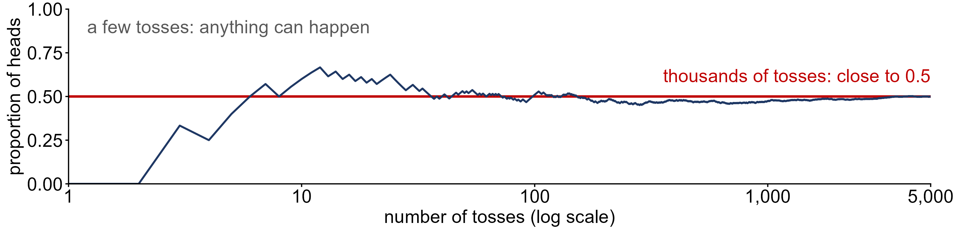
The law of large numbers
law of large numbers
as the number of independent trials n increases, the relative frequency of an event, (number of times A occurs) / n, gets closer and closer to P(A)
Independent trials: the outcome of one trial does not affect the outcome of any other
Jacob Bernoulli proved it (published 1713); Karl Pearson tossed a coin 24,000 times: 12,012 heads = 0.5005

Slide 13
The rules of probability
Rule 1: 0 ≤ P(A) ≤ 1
the probability of an event must be a value between 0 and 1
Rule 2: Σ P(A_{i}) = 1
the probabilities of all the outcomes in the sample space must add to 1
Rule 3: P(A ∪ B) = P(A) + P(B)
the addition rule for DISJOINT events: A and B have no outcomes in common
Rule 4: P(A′) = 1 − P(A)
the complement rule: A′ ("A-not") is every outcome in S that is not in A

Slide 14
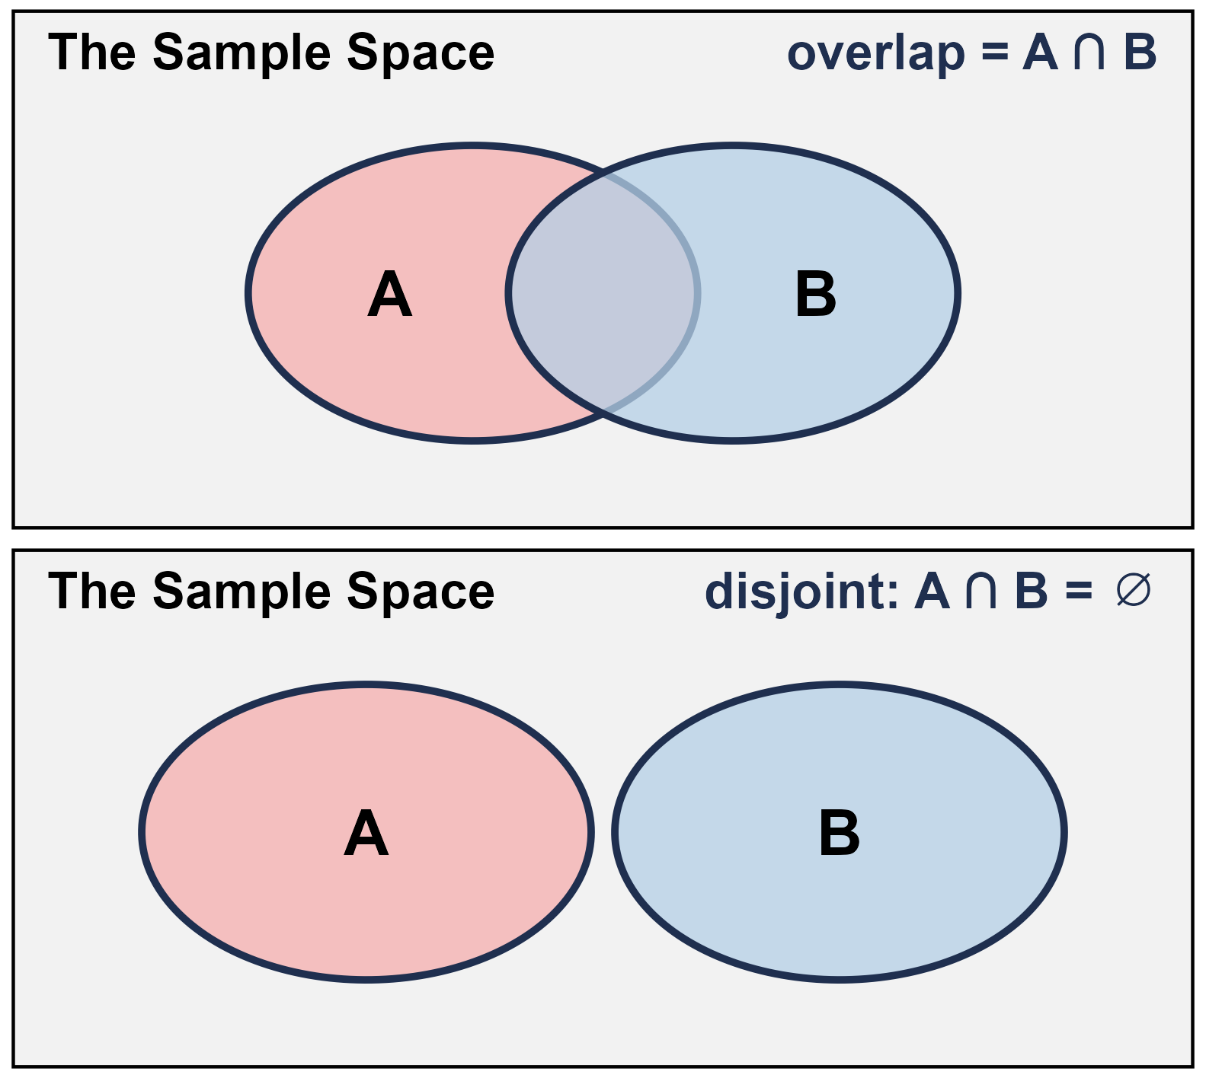
Combining two events
union A ∪ B
outcomes in A or in B (or both); key word "or"
intersection A ∩ B
outcomes A and B have in common; key word "and"
disjoint (mutually exclusive)
A and B have no outcomes in common: A ∩ B = ∅

Slide 15
Two more rules
general addition rule
P(A ∪ B) = P(A) + P(B) − P(A ∩ B): subtract the overlap so it is not counted twice
multiplication rule
if A and B are independent (one occurring does not change the probability of the other): P(A ∩ B) = P(A) · P(B)
disjoint ≠ independent
disjoint events cannot happen together, so knowing one happened tells you the other did not

Slide 16
Example: one die
Roll a fair six-sided die once.
S = {1, 2, 3, 4, 5, 6}, each outcome has probability 1/6
(a) What is P(not a six)?
(b) What is P(1 ∪ 6)?
(c) What is P(even ∪ greater than 3)?
(a) 1 − 1/6 = 5/6 (rule 4)
(b) 1/6 + 1/6 = 1/3 (rule 3: a 1 and a 6 are disjoint)
(c) 3/6 + 3/6 − 2/6 = 4/6 (the 4 and the 6 are in both)

Slide 17
Example: two dice
Roll a fair die twice. The two rolls are independent.
P(six) = 1/6 on each roll
(a) What is P(six on both rolls)?
(b) What is P(at least one six)?
(a) (1/6)(1/6) = 1/36 (multiplication rule)
(b) 1 − P(no sixes) = 1 − (5/6)(5/6) = 11/36 ≈ 0.31

Slide 18
Example: unions and intersections
Pick one of the 379 students at random. F = female, T = at least 70 in.
 | At least 70 in | Under 70 in | Total
Female | 19 | 243 | 262
Male | 87 | 30 | 117
Total | 106 | 273 | 379
(a) What is P(F ∩ T)?
(b) What is P(F ∪ T)?
(a) 19 / 379 ≈ 0.05
(b) 262/379 + 106/379 − 19/379 = 349/379 ≈ 0.92

Slide 19
Are F and T independent?
Pick one of the 379 students at random. F = female, T = at least 70 in.
 | At least 70 in | Under 70 in | Total
Female | 19 | 243 | 262
Male | 87 | 30 | 117
Total | 106 | 273 | 379
Does knowing a student is female change the chance they are at least 70 in?
Yes: 106/379 ≈ 28% of all students, but only 19/262 ≈ 7% of the women
Not independent: P(F) · P(T) ≈ 0.69 · 0.28 ≈ 0.19, but P(F ∩ T) ≈ 0.05

Slide 20
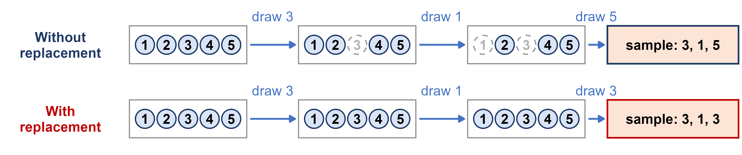
With or without replacement?
Week 4: drawing a sample of 3 balls from a bag of 5, two ways.
Are the draws independent?
With replacement: yes. The bag is the same on every draw, so P(A ∩ B) = P(A) · P(B)
Without replacement: no. Each draw changes what is left, so the next probability depends on the last draw

Slide 21
Example: drawing two aces
A standard deck has 52 cards, 4 of them aces. Draw two cards.
P(ace on the first draw) = 4/52
(a) What is P(two aces) if the first card is put back (with replacement)?
(b) What is P(two aces) if it is not put back (without replacement)?
(a) (4/52)(4/52) = 1/169 ≈ 0.0059: the draws are independent
(b) (4/52)(3/51) = 1/221 ≈ 0.0045: only 3 aces are left among 51 cards

Slide 22
Random variables
random variable
the outcome of a random trial recorded as a number, written with a capital letter such as X
discrete
its possible values can be listed: the number of heads in 3 tosses, X = 0, 1, 2, 3
continuous
it can take any value in an interval: a student's height

Slide 23
Example: three coin tosses
Toss a fair coin 3 times: 2 × 2 × 2 = 8 equally likely outcomes.
X = the number of heads
(a) List the sample space S.
(b) How many outcomes give each value of X?
S = {HHH, HHT, HTH, THH, HTT, THT, TTH, TTT}
X = 0: 1 X = 1: 3 X = 2: 3 X = 3: 1 (out of 8)

Slide 24
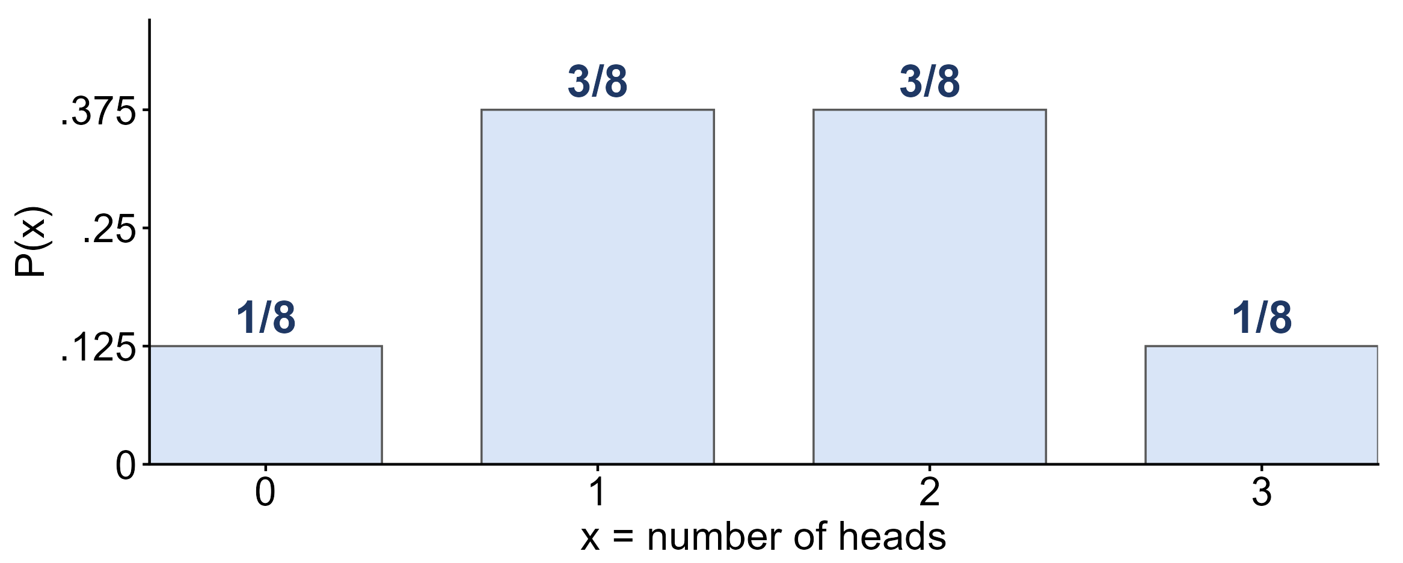
Discrete probability distributions
probability distribution
a function that assigns a probability to each possible value of X; each is between 0 and 1, and they add to 1
1 + 3 + 3 + 1 = 8, so the probabilities add to 8/8 = 1

Slide 25
Example: using a distribution
X = the number of heads in 3 tosses of a fair coin.
P(0) = 1/8 P(1) = 3/8 P(2) = 3/8 P(3) = 1/8
(a) What is P(X ≥ 2)?
(b) What is P(X ≤ 1)?
(c) What is P(1 ≤ X ≤ 2)?
(a) 3/8 + 1/8 = 4/8
(b) 1 − P(X ≥ 2) = 1 − 4/8 = 4/8
(c) 3/8 + 3/8 = 6/8

Slide 26
The mean of a random variable
expected value μ
the long-run average of X: μ = Σ x · P(x)
variance σ²
σ² = Σ (x − μ)² · P(x), and the standard deviation is σ = √σ²
three coin tosses
μ = 0(1/8) + 1(3/8) + 2(3/8) + 3(1/8) = 1.5 heads

Slide 27
Example: grade points
A STAT 251 exam grade on the 4-point scale, for a student chosen at random:
x | 0 | 1 | 2 | 3 | 4
grade | F | D | C | B | A
P(x) | 0.05 | 0.10 | 0.30 | 0.25 | 0.30
(a) What is P(better than a C)?
(b) What is the mean grade, μ?
(a) P(X = 3) + P(X = 4) = 0.25 + 0.30 = 0.55
(b) μ = 0(0.05) + 1(0.10) + 2(0.30) + 3(0.25) + 4(0.30) = 2.65

Slide 28
What you should know: probability
probability
long-run relative frequency, between 0 and 1; the law of large numbers is why it works
the rules
P(A′) = 1 − P(A); P(A ∪ B) = P(A) + P(B) − P(A ∩ B); independent: P(A ∩ B) = P(A) P(B)
random variables
a discrete distribution lists the values of X and probabilities that add to 1; μ = Σ x P(x)

